Slide 1
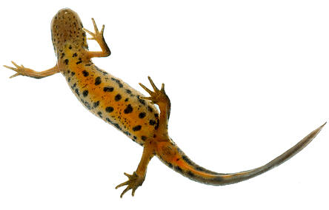
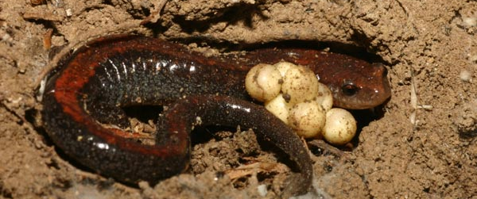
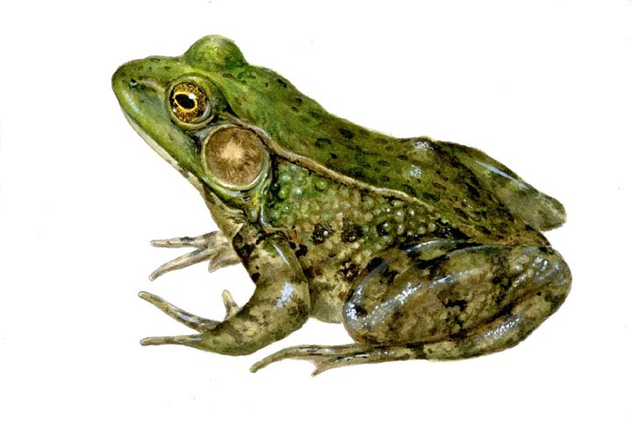
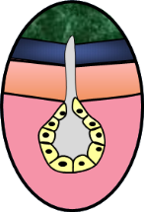
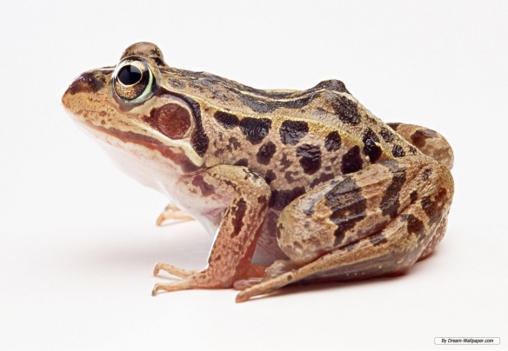
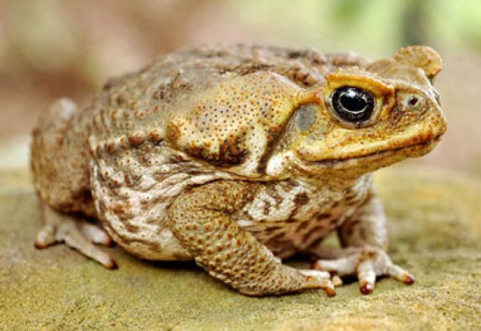
AMPHIBIA
These animals differ from the fish in the lack of scales
They have mucus glands in the skin and a three chambered heart.
Respiration is through either grill or lungs.
They lay eggs.
These animals are found both in water and land.
Frogs, toads and salamanders are examples.
Mucus glands

Slide 2
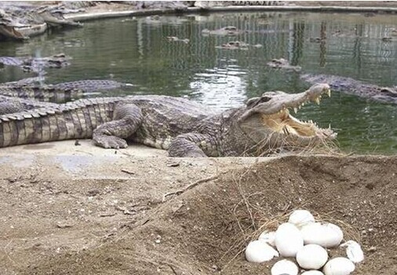
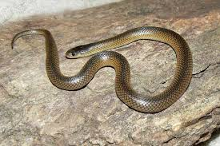
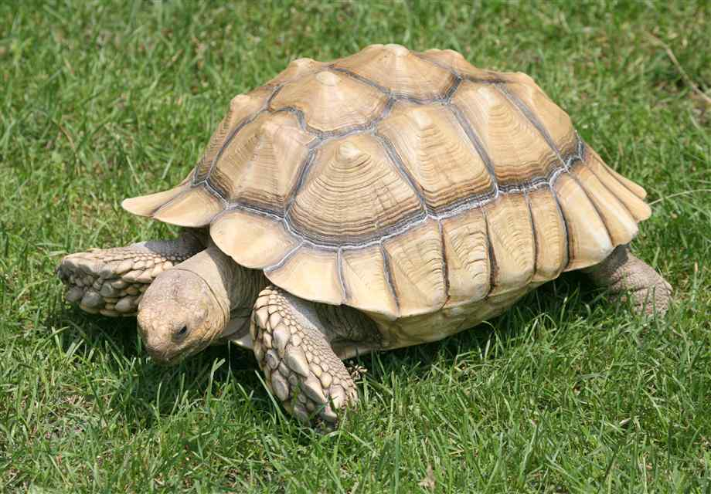
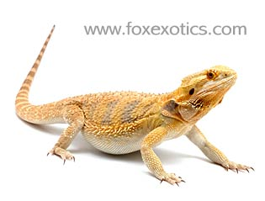
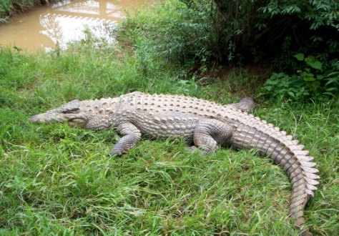
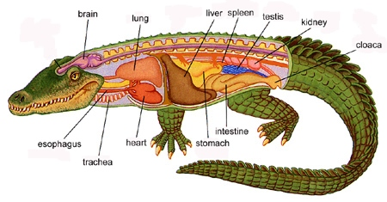
REPTILIA
These animals are cold-blooded, have scales and breathe through lungs.
While most of them have a three-chambered heart, crocodiles have four heart chambers.
They lay eggs with tough coverings and do not need to lay their eggs in water, unlike amphibians.
Snakes, turtles, lizards and crocodiles fall in this category

